Slide 1
Husnain Momin
BSCS-1B
Presented to: Ma’am Zarmina

Slide 2
About Myself
I was born in Lahore, in the fall of 2002, which makes me 19 years old at the moment. I studied in LGS (MT) till 5th grade, after which I had to change schools and completed my matriculation from Unique High School. My Intermediate was also through Unique boys college.
Currently, I’m pursuing a bachelor’s degree from Riphah International University in computer sciences.

Slide 3
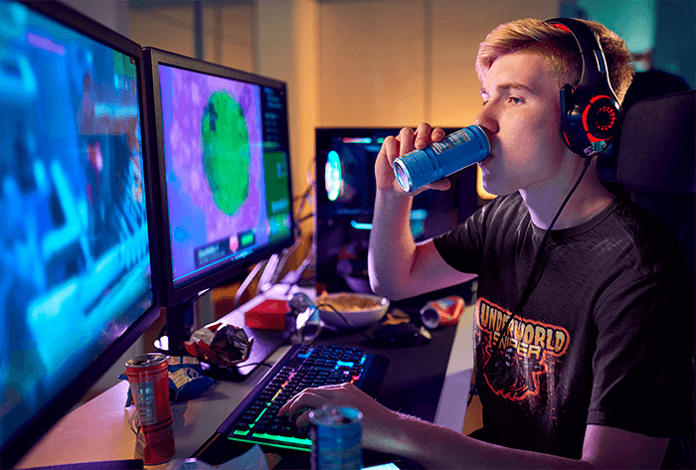
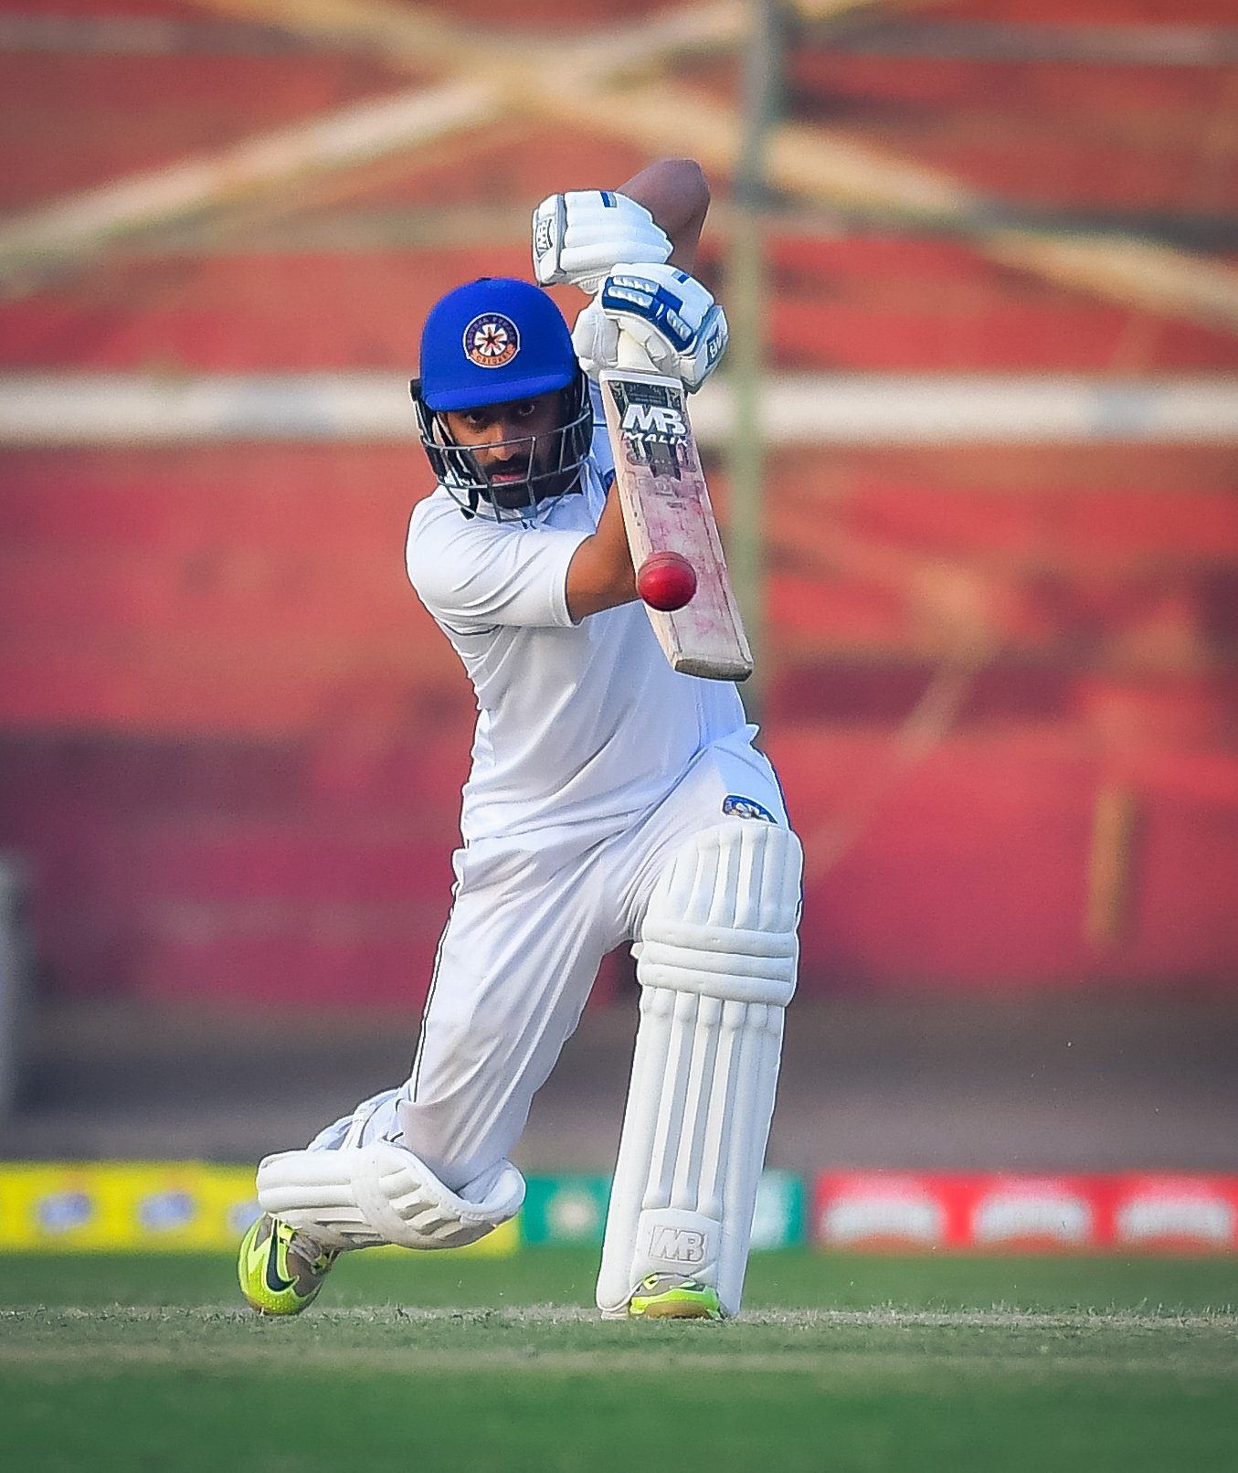

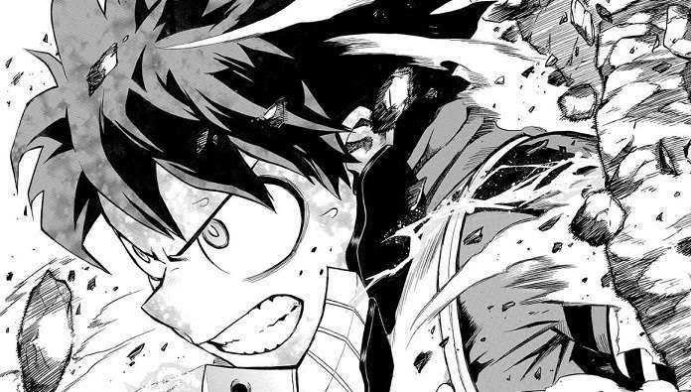
My Hobbies
Some of my hobbies include playing video games, watching Netflix, playing cricket and reading.
My favorite hobby out of these is to play video games on my computer. It is really entertaining as I can play with my friends too.

Slide 4
Why be a Computer Scientist?
A computer scientist is like a necessity to the world right now. Currently, almost everything in the world is somehow linked with computers. Programs, applications, mobile phones everything is made possible with the help of a computer scientist. They are the future because the world is developing at a very fast rate which will result in a digitalized new era which no one has ever seen before.

Slide 5
Thank you

